Slide 1
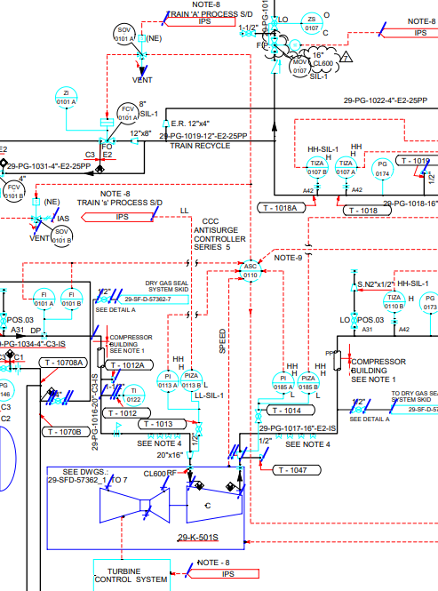

AI for Smart P&IDs
AI model which unifies text, symbols recognition
Notes:
We are all familiar with Smart P&IDs and Flat Filed PDFs.
In today's business presentation, we will delve into the exciting topic of leveraging AI technology to transform static PDF documents into dynamic and intelligent Smart P&IDs.

Slide 2

AI for Smart P&IDs
Conceptualized by Lavanya Sreeram
17 May 2023
Notes:
The crowd in the room knows me well. I am excited to be among such company and have this association with this department.

Slide 3
Digital Transformation and Legacy Systems
Major part of transformation involves digitizing Engineering Drawings – paper drawings, PDFs.
Current situations are:
Drawing digitization is done manually
Drawing digitization/conversion is not started
Notes:
Digital Transformation!
More and more companies are embracing new technology. They call it digital transformation. But when it comes to digitizing Engineering drawings though - there are very few solutions.
It is unsurprising that a majority of businesses still rely on manual methods or have yet to initiate their digitization journey.

Slide 4
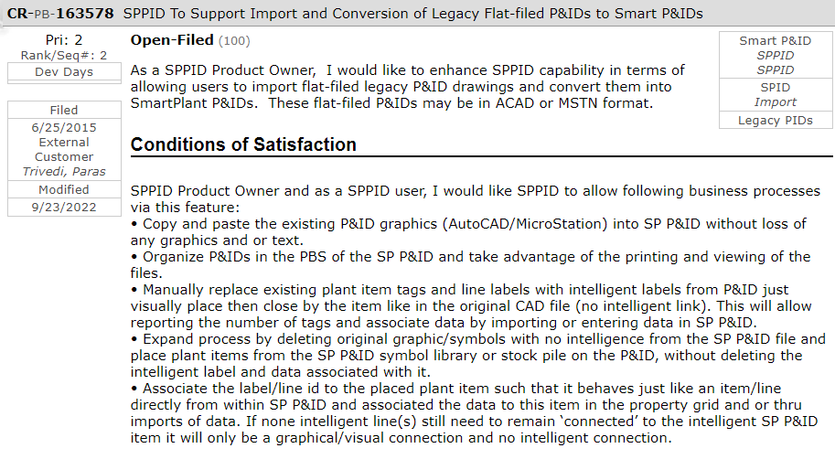
Businesses are wanting & waiting for the easy solution
Reference:
CR-PB-163578 - SPPID To Support Import and Conversion of Legacy Flat-filed P&IDs to Smart P&IDs
Notes:
As a product & software provider, we received this request and our teams captured this requirement in the CR you see on screen.

Slide 5
Model - Overview
Train the model on PDFs- supervised learning
Identify & Extract Symbols, X,Y from PDFs – using objection detection
Match symbol to Ground truth
i.e. Hexagon symbol legend– using similarity or classification
Also, Identify & Extract Tags using – OCR / text recognition
Integrate with Smart P&ID
Use above Symbols, Location & Tags as input
Create Smart P&IDs using Plaice llama automation
Update Tags – Create Smart PIDs
Legend- Hexagon Technology - ML Techniques
Notes:
By combining object detection and OCR techniques, you can achieve a comprehensive conversion process for PDFs to Smart P&IDs. Object detection helps in accurately identifying and extracting the symbols, while OCR assists in extracting the associated textual information. This combined approach ensures that both the visual representation of the symbols and the associated text are captured and utilized effectively in generating intelligent P&IDs.
It's important to note that the effectiveness of the conversion process depends on the quality and consistency of the PDFs, the complexity of the symbols, and the accuracy of the object detection and OCR algorithms employed. Customization and fine-tuning of these techniques may be necessary to meet specific requirements and achieve optimal results for converting PDFs to Smart P&IDs.

Slide 6
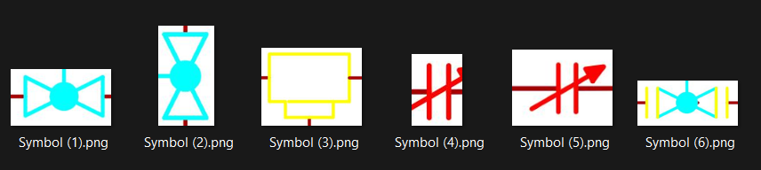
Reference for AI Model:
Notes:
On the screen, we can see 6 different symbols. These will act as ground truth to the AI model.
For demo, I have developed these symbol “templates” or references based on domain knowledge, reflecting commonly used elements in Engineering P&IDs. These are our templates, our symbols, we will tell AI to detect these objects in the input pdfs. That’s object detection

Slide 7
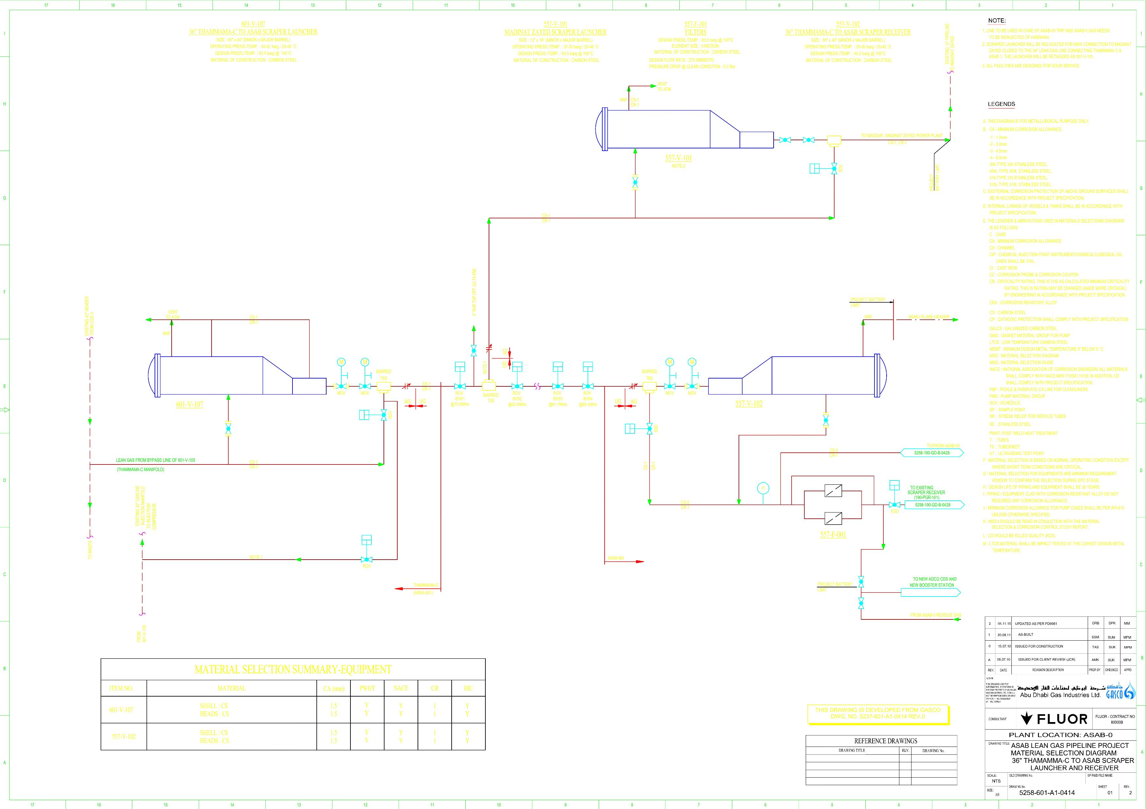
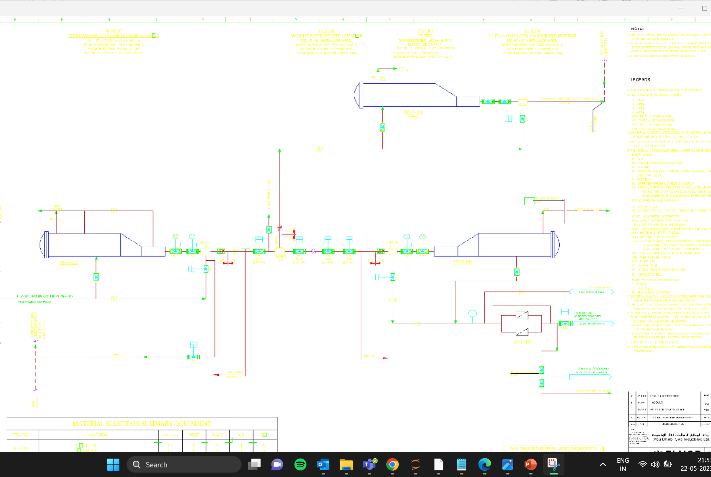
Kindly adjust with the image quality!
Zoomed in version is available on next slide.
Input Image to model:
Output Image from model:
Notes:
Leveraging AI from OpenCV, we successfully extract these symbol (templates) from the PDFs. After iterating over all the symbols / templates, model draws bounding boxes around the matched locations on the original image.
A zoomed in picture is shown in next slide.

Slide 8
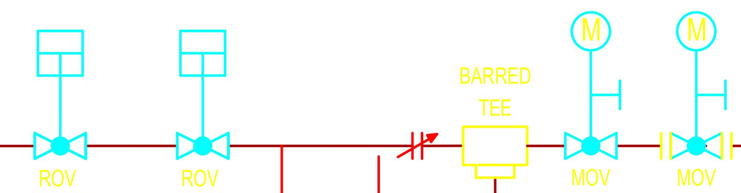
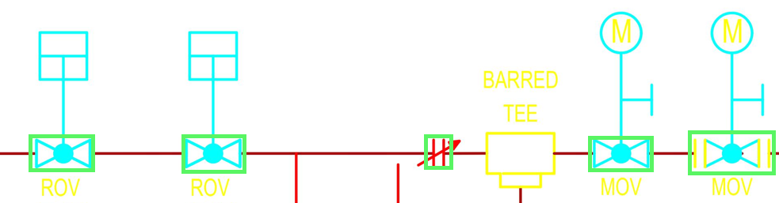
Input:
Output 1 – Bounded Boxes for symbols
Notes:
Each symbol’s name and symbol location is precisely determined, and the positions are then converted to Engineering document X and Y coordinates, ensuring accurate representation.
Some work is still needed - to obtain the most robust and reliable matches for our symbol templates, ensuring the accuracy of the extracted symbols. That no other model can beat. ☺
AI output - The output is presented as an image where symbols if identified are highlighted with green bounding boxes.
Additionally, the model extracts the cartesian coordinates which can be easily converted to precise location coordinates (x, y) that engineering systems use.
Model also extracts the corresponding symbol names for each identified instance.

Slide 9
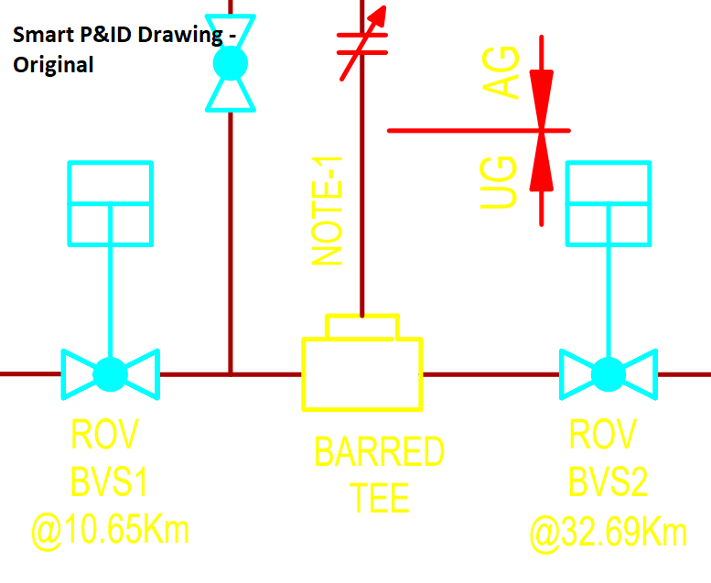
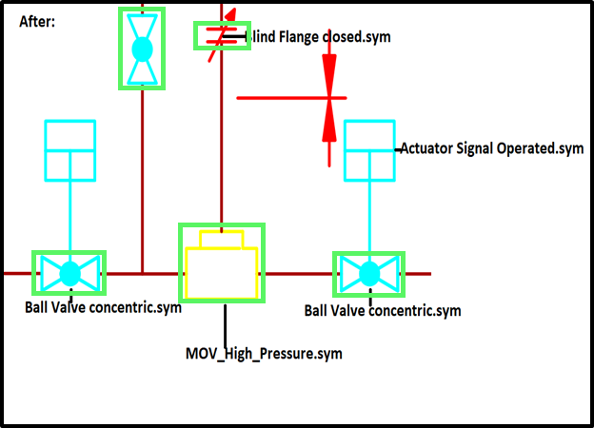
Output 2 & 3 – Symbol Name, Symbol Locations

Slide 10
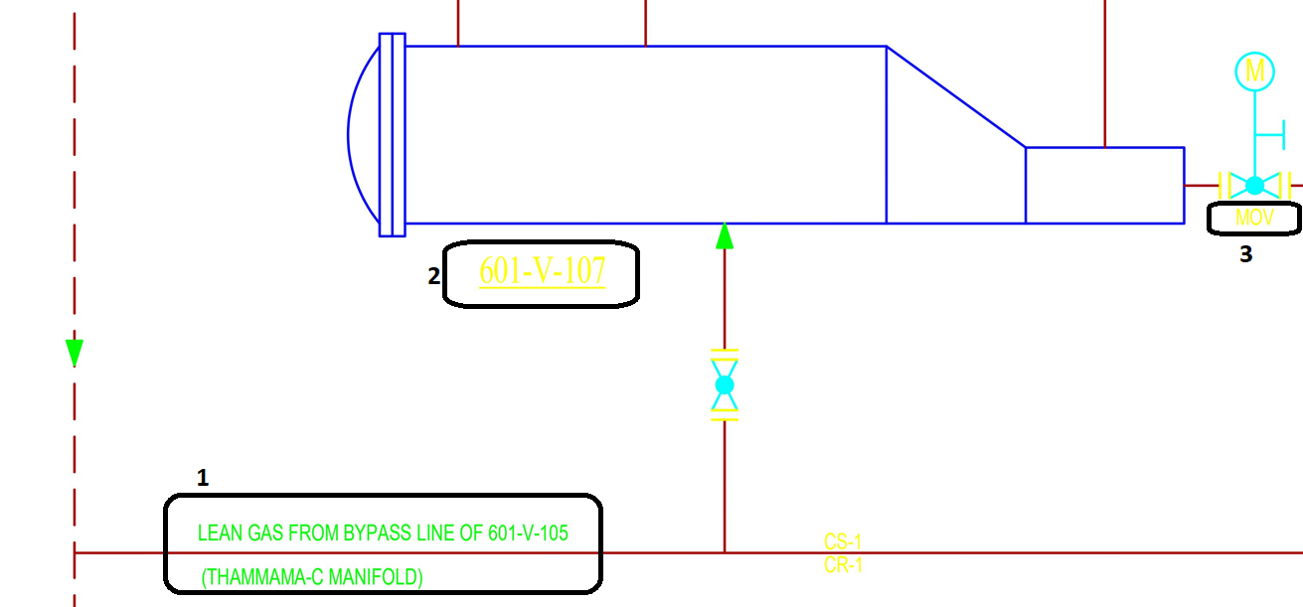
Output 4 - Text recognized by OCR
Notes:
Our journey doesn't end with visual elements. We further unlock the potential of the PDFs by extracting text using Optical Character Recognition (OCR).
This text extraction enables us to add crucial engineering properties and Tag Names to the recreated Smart P&IDs.
The engineering PID PDFs contains valuable information such as Tag Names and Tag Engineering Properties. To achieve this, we employ Optical Character Recognition (OCR) techniques to extract and interpret the text from the PDF files. OCR allows us to convert the textual content into machine-readable format for further analysis and utilization.
Th text recognized can be 1. Tag Information, 2. Tag Name (Item Tag) 3. Tag Type (MOV- Motor Operated Valve)

Slide 11
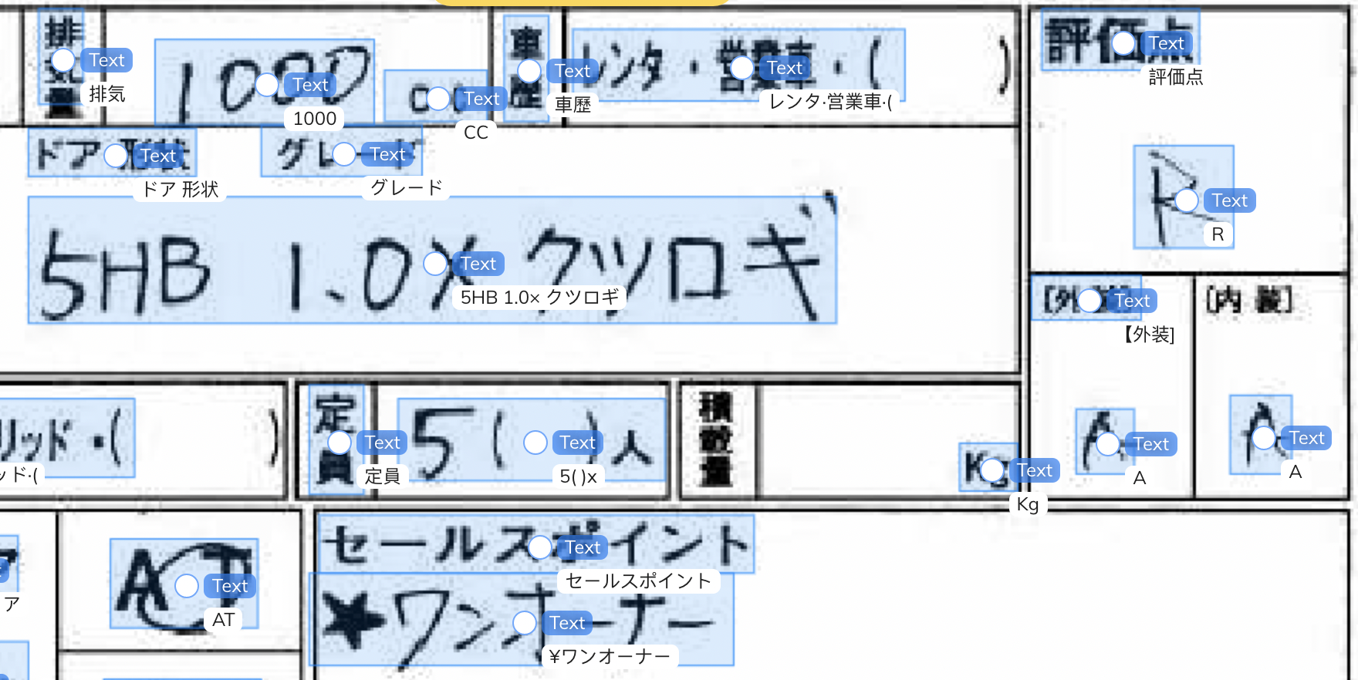
Output 4 – Text Extraction using OCR. ---gives Text & Tag information.
Notes:
Fusion team already shown the capabilities in our tools, some of you may recognize it from there.

Slide 12
Overview
Symbols, sym file name, location
Tags, Text
Create Smart PID using PLAICE
Notes:
By combining visual symbols with enriched textual information, we elevate our PDFs to a whole new level of intelligence. Making it ready for Smart PID creation stage

Slide 13
Model - Overview
Train the model on PDFs- supervised learning
Identify & Extract Symbols, X,Y from PDFs – using objection detection
Match symbol to Ground truth
i.e. Hexagon symbol legend– using similarity or classification
Also, Identify & Extract Tags using – OCR / text recognition
Integrate with Smart P&ID
Use above Symbols, Location & Tags as input
Create Smart P&IDs using Plaice llama automation
Update Tags – Create Smart PIDs
Legend- Hexagon Technology - ML Techniques
Notes:
By combining object detection and OCR techniques, you can achieve a comprehensive conversion process for PDFs to Smart P&IDs. Object detection helps in accurately identifying and extracting the symbols, while OCR assists in extracting the associated textual information. This combined approach ensures that both the visual representation of the symbols and the associated text are captured and utilized effectively in generating intelligent P&IDs.
It's important to note that the effectiveness of the conversion process depends on the quality and consistency of the PDFs, the complexity of the symbols, and the accuracy of the object detection and OCR algorithms employed. Customization and fine-tuning of these techniques may be necessary to meet specific requirements and achieve optimal results for converting PDFs to Smart P&IDs.

Slide 14
Proposed Solution – AI for Smart P&IDs
AI model which unifies text, symbols, engineering attributes, drawing template sizes
Integrates with Smart P&ID – data imported/created in Hexagon Smart P&ID
Proposed AI solution will extract key information from PDFs.
Convert the engineering schematics / P&ID PDFs into Smart P&IDs with no coding required for end user businesses.
Notes:
In conclusion, our approach showcases a remarkable advancement in converting flat filed PDFs of Engineering P&IDs into dynamic Smart P&IDs. With our template extraction, SIFT optimization, and OCR text recognition, we can efficiently recreate P&IDs with accuracy and unlock vital engineering insights. By embracing this digital transformation, we enhance our productivity, decision-making, and overall operational efficiency.

Slide 15
Pre-process Smart P&IDs using PLAICE- to be used for Testing
Notes:
Assumption – Hexagon Smart PID drawings which will be used on training for first phase model will be closely similar to AutoCAD PDFs, flat-filed PDFs
Pre-process Smart P&IDs - using Plaice Automation
Start with Smart P&IDs
Utilize Plaice Automation to perform the pre-processing steps.
Initiate by removing symbols categorized as Label/Text from the Smart P&IDs.
Add a new text label to each item, displaying the symbol name and symbol type. This effectively labels the dataset.
Convert the batch of Smart P&IDs to PDFs, ensuring diversity in the testing dataset by including both color and black-and-white versions. Generate PDFs at resolutions of 1200dpi, as well as 900dpi and below.
The resulting dataset, with the added labels, will serve as the test dataset or labeled data for the AI/ML model.

Slide 16
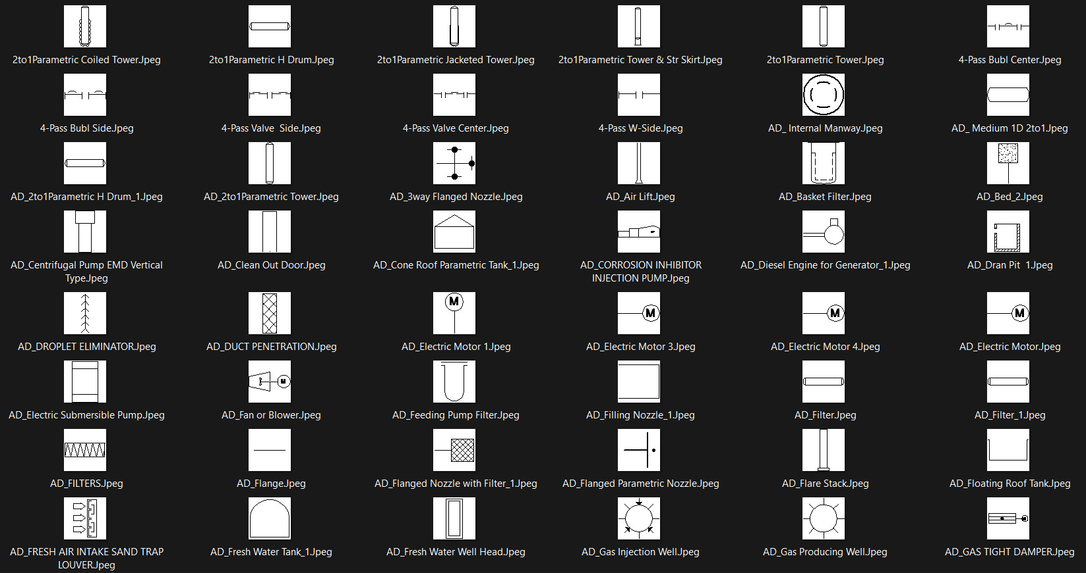
References / Existing Shapes or Symbol legend:
Notes:
Work involved in creating optimal size symbol and drawing images. And into which format.

Slide 17
ML Model Testing – Technical Overview
Testing for:
Speed
F1 Score for Symbol extraction
F1 Score for Text Extraction
Pre-process test PDFs
Predict Symbol of Image using model. Extract Text
Performance Metrics / F1 Score
Notes:
Slide: Evaluating Extraction Performance
Objective: Ensure accuracy and efficiency of the extraction process by leveraging key metrics and testing techniques.
F1 score is a metric that helps to find right balance between correctly identifying positive instances and minimizing false positives and false negatives
1. Confusion Matrix:
- A powerful tool for evaluating the performance of our extraction system.
- Helps us understand the true positives, true negatives, false positives, and false negatives.
- Enables a comprehensive analysis of the system's precision, recall, and overall effectiveness.
2. F1 Score:
- The F1 score provides a holistic measure of the extraction system's accuracy.
- Balances the precision and recall to assess the system's overall performance.
- Helps us gauge the effectiveness of the extraction process in capturing both symbols and textual information.
3. Speed Evaluation:
- Assessing the extraction speed is crucial to ensure efficient processing.
- Measure the time taken to process a given number of PDFs and extract symbols and text.
- Optimize the system to achieve the desired extraction speed without compromising accuracy.
4. Testing Methodology:
- Employ a diverse set of flat filed PDFs representing different scenarios and complexities.
- Manually verify the extracted symbols and text against ground truth data to evaluate accuracy.
- Calculate the F1 score and analyze the confusion matrix for performance assessment.
5. Iterative Improvement:
- Continuously refine the extraction model based on feedback and analysis of testing results.
- Fine-tune parameters, improve template matching techniques, and optimize OCR algorithms.
- Aim to achieve higher accuracy, faster processing times, and robust performance across various PDF types.
Conclusion:
By utilizing the confusion matrix, F1 score, and speed evaluation, we can ensure the extraction system's accuracy and efficiency. Rigorous testing and iterative improvement allow us to fine-tune the system for optimal performance, ensuring reliable and precise extraction of symbols and text from flat filed PDFs.
Note: Please ensure that the slide's content aligns with the specific testing and evaluation methods used in your project.

Slide 18
Dummy Performance Metrics:
 | Predicted
 | Valve | Not Valve
Actual Valve | TP (50) | FN (20)
Actual Not Valve | FP (10) | TN (70)
Notes:
Sure! Let's break it down in simpler terms.
The "F1 score" is a way to measure the overall performance of a system or model. It takes into account how well it identifies positive outcomes (like finding something valuable or important).
A "True positive" specifically refers to situations when the system correctly identifies something as positive when it actually is positive. It means the system is doing a good job of recognizing what we want it to find.
So, the F1 score considers both how well the system identifies positive outcomes and how many true positive results it gets. It helps us understand how effective the system is at finding what we're looking for.

Slide 19
Model Performance:
True Positives (TP): The model correctly predicted 45 instances as Valve.
False Positives (FP): The model incorrectly predicted 25 instances as Valve when they were actually Not Valve.
True Negatives (TN): The model correctly predicted 65 instances as Not Valve.
False Negatives (FN): The model missed 15 instances that were actually Valve and predicted them as Not Valve.

Slide 20
Goal - Our Model to perform with ~100% accuracy.
Notes:
Sure! Let's break it down in simpler terms.
The "F1 score" is a way to measure the overall performance of a system or model. It takes into account how well it identifies positive outcomes (like finding something valuable or important).
A "True positive" specifically refers to situations when the system correctly identifies something as positive when it actually is positive. It means the system is doing a good job of recognizing what we want it to find.
So, the F1 score considers both how well the system identifies positive outcomes and how many true positive results it gets. It helps us understand how effective the system is at finding what we're looking for.

Slide 21

Schedule
Create Train dataset –i.e. PDFs, Distinct Symbol Legend, Text 2 weeks
Create model, run multiple models for best model, improve accuracy, test model
2 weeks
Integrate with Smart P&ID, Test
4-6 weeks
Handover!

Slide 22

Future scope 1 - User configuration simplified User can customize look of the symbols with one click like emojis skin selection
Notes:
Let us talk configuration. We are hoping all done well, user will be able to upload the symbol legend as PDF drawing. One set of Smart P&ID symbols available and placed in Reference Data. This will be the only configuration needed from user’s perspective. This provision of PDF legend and symbol legend wil add as an additional fine tune training as per customer’s custom symbols, that’s all. It will be like choosing skin tone for emojis when all else is in place.

Slide 23
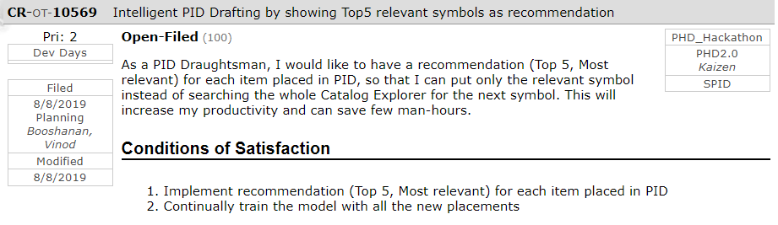
Future Scope 2
Integrate a refined & targeted version of already developed Hackathon PHDv2.0 2019 Winning Idea “IntelliDraft”.
References to “IntelliDraft”:
CR-OT-10569 : Intelligent PID Drafting by showing Top5 relevant symbols as recommendation
RI-PB-229800 : Recommendation Engine for Smart Catalog Explorer in SPID

Slide 24
Resources required:
System with strong computational capacity- Spec TBD

Slide 25
Resources & Technologies used:
High Quality PDF to jpeg conversion: Adobe, https://smallpdf.com/
Python, AI/ML objection detection algorithms, OCR.
Hexagon SmartP&ID Plaice Automation

Slide 26
Thankyou!

